Slide 1
COSC 6336 Statistical Methods in Data Analytics
Fettah Kiran Mohammad Imtiaz Nur

Slide 2
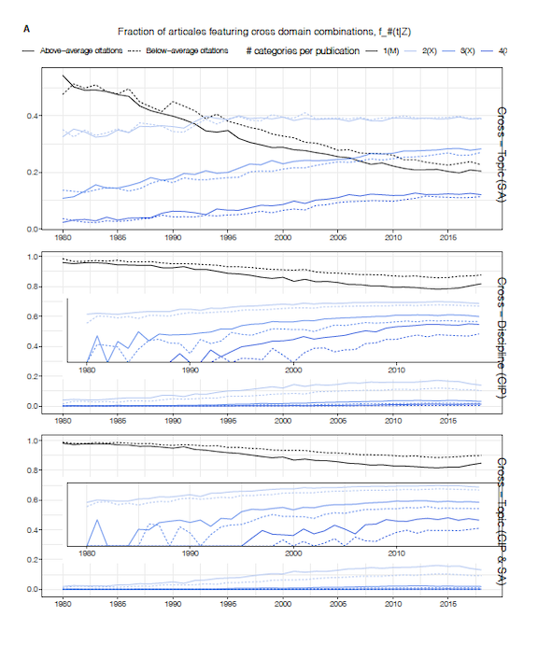
Figure 2A

Slide 3
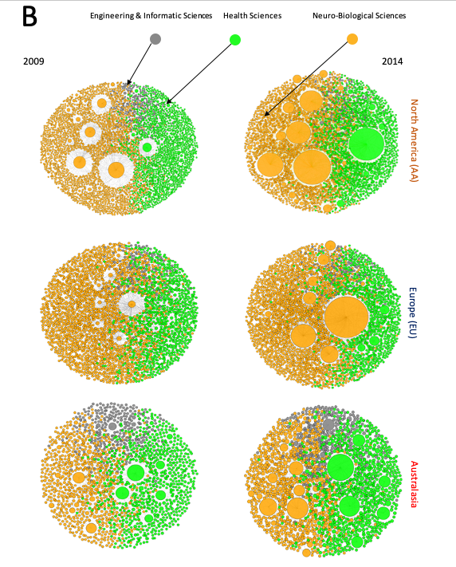
Figure 2B

Slide 4
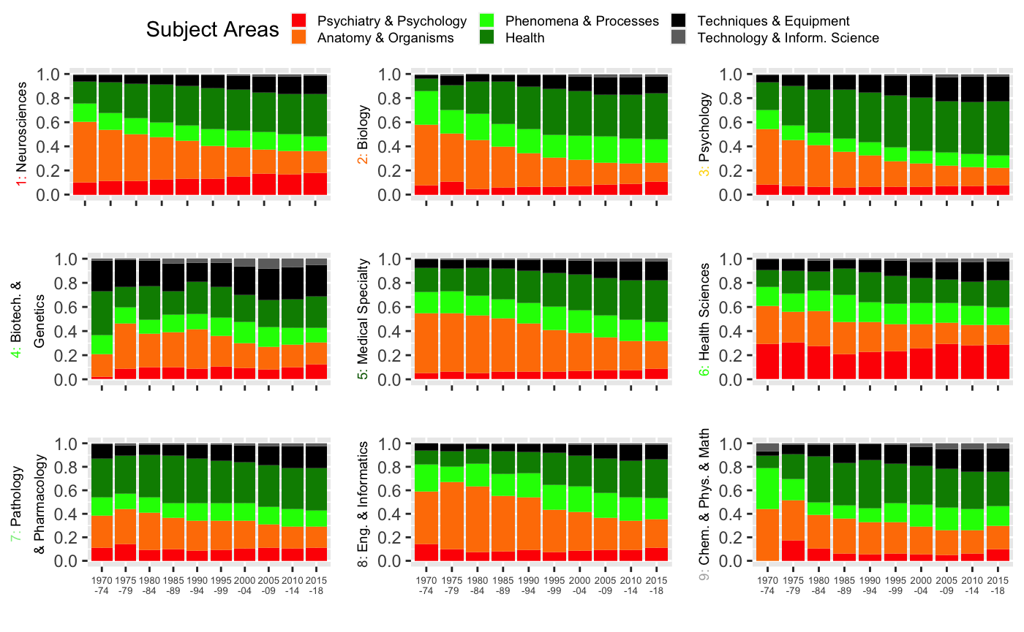
Figure 3A

Slide 5
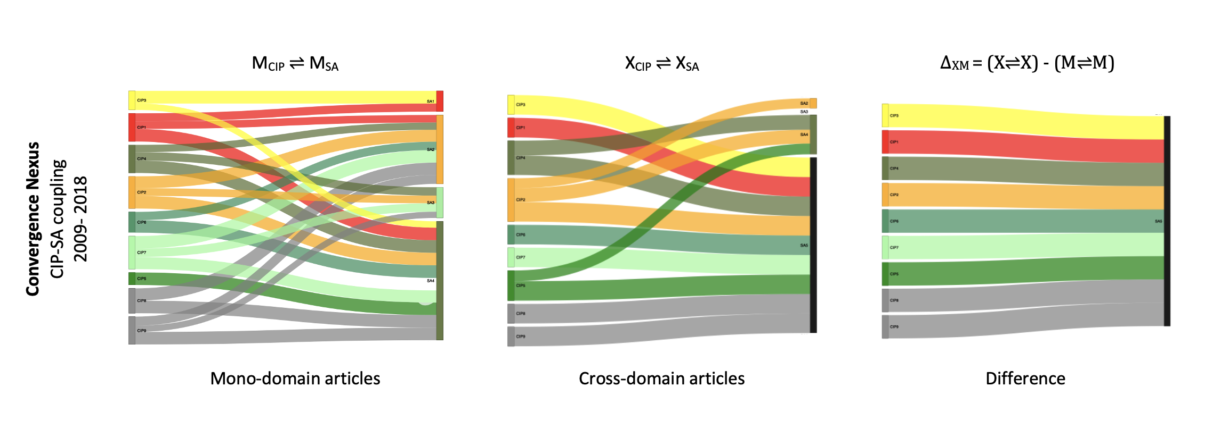
Figure 3-B

Slide 6
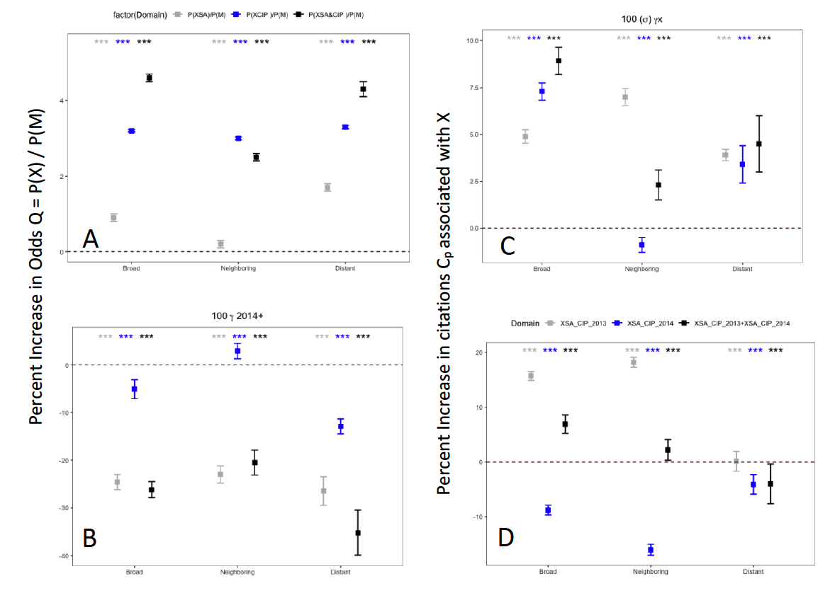
Figure 5

Slide 7
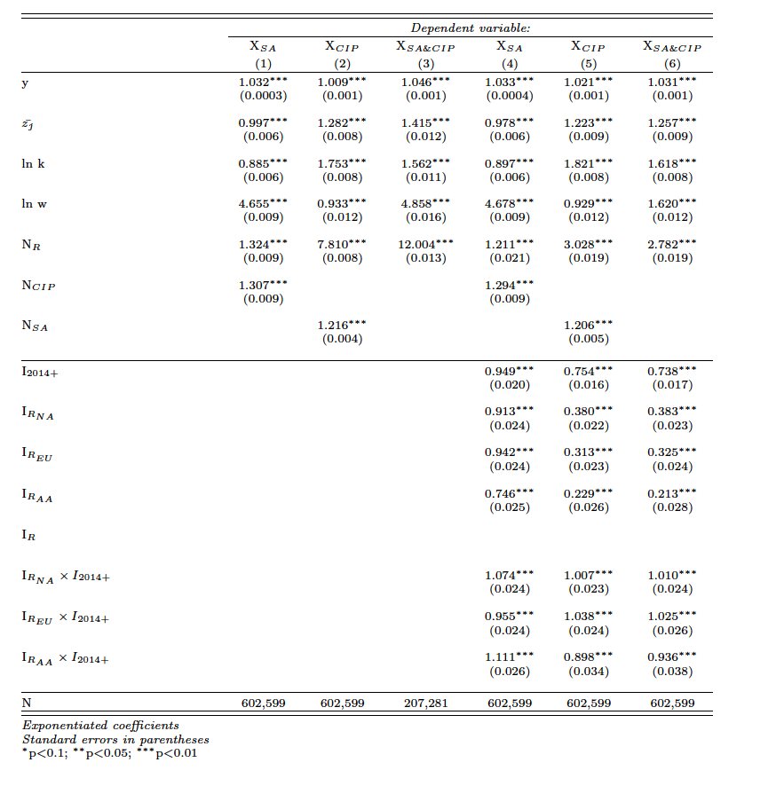
S1

Slide 8
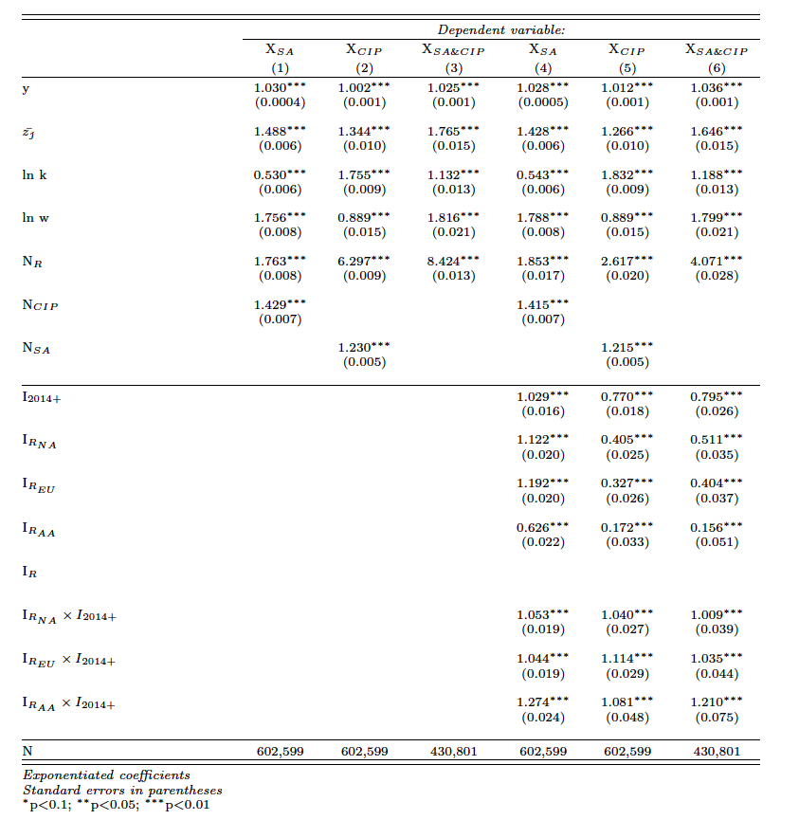
S2

Slide 9
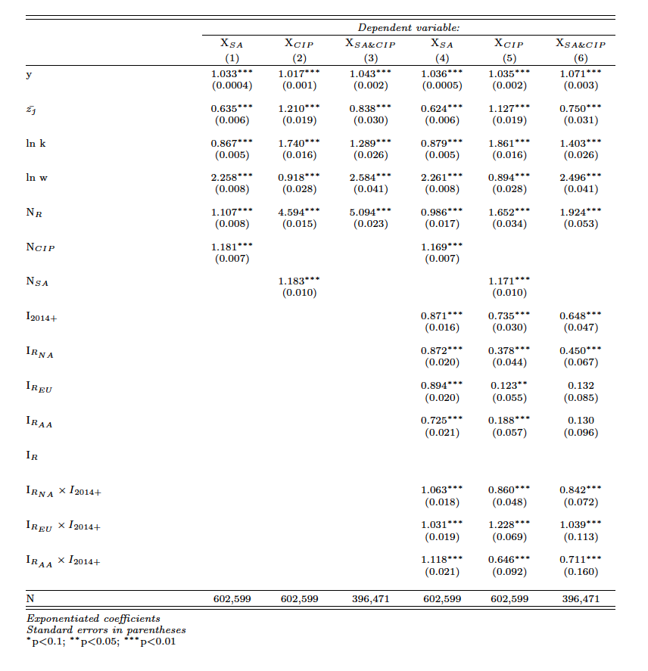
S3

Slide 10
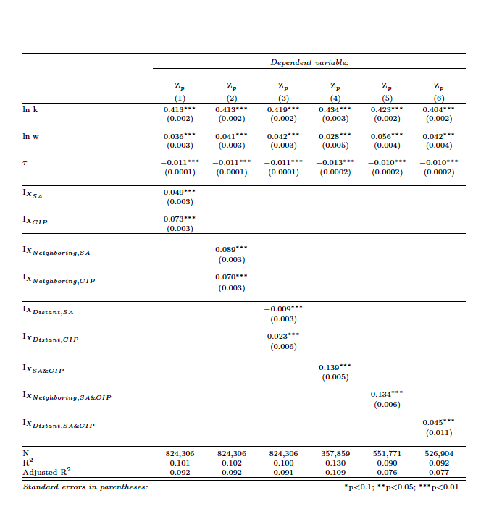
S4

Slide 11
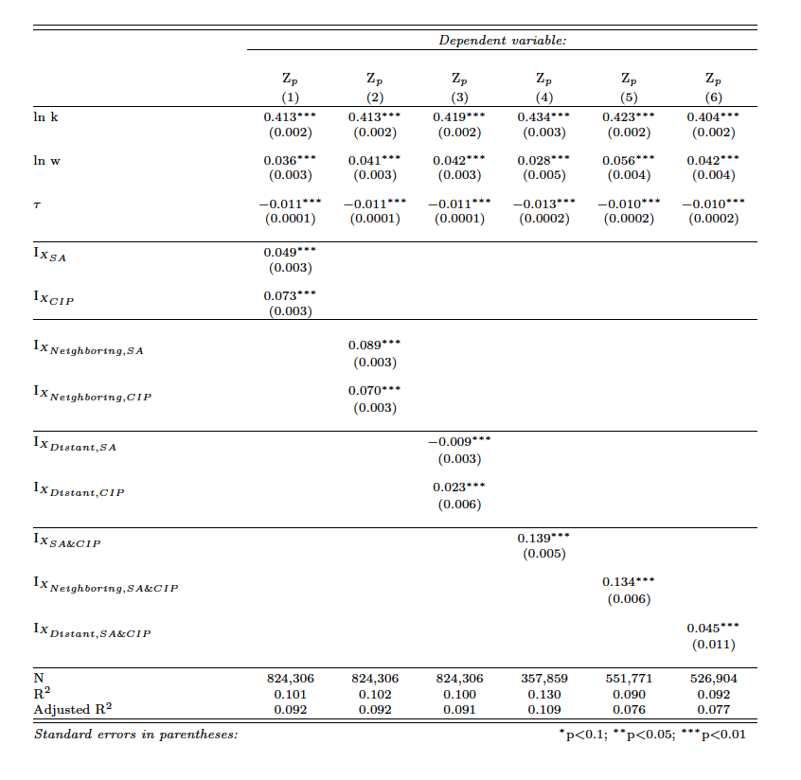
S5

